Slide 1

Entering the Zettabyte Age
Jeffrey Krone
.
1 Kilobyte 1,000 bits/byte
1 megabyte 1,000,000
1 gigabyte 1,000,000,000
1 terabyte 1,000,000,000,000
1 petabyte 1,000,000,000,000,000
1 exabyte 1,000,000,000,000,000,000
1 zettabyte 1,000,000,000,000,000,000,000

Slide 2
Presentation Outline
The Evolution of Data
Previous Data Solutions (Shard’ing, SANS)
The Hadoop Ecosystem
Hadoop Case Study – Financial Institution
Founded Zettaset to address some of the deficiencies inherent in a Big Data Infrastructure such as Hadoop
Utilizing Flash Drives with Hadoop
Implications of utilizing Hadoop in a Cloud Computing Environment
Open Problems to be addressed

Slide 3
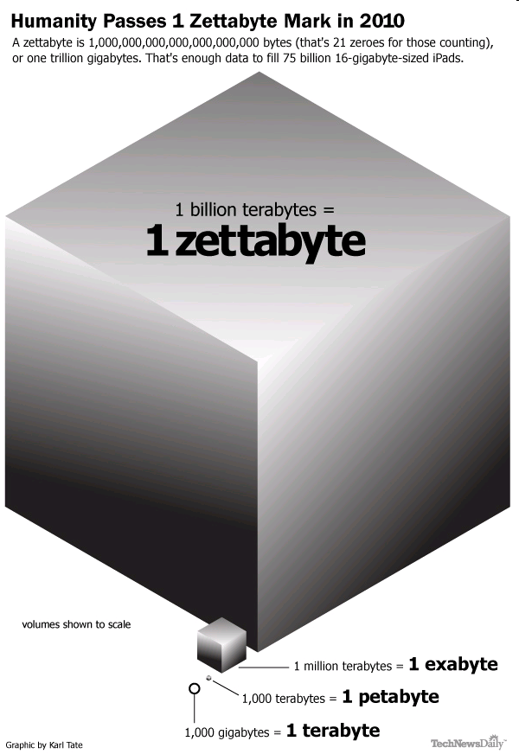
Data volume is growing exponentially
Estimated Global Data Volume:
  2011: 1.8 ZB
  2015: 7.9 ZB
The world's information doubles every two years
Over the next 10 years:
  The number of servers worldwide will grow by 10x
  Amount of information managed by enterprise data centers will grow by 50x
  Number of “files” enterprise data center handle will grow by 75x
Source: http://www.emc.com/leadership/programs/digital-universe.htm, which was based on the 2011 IDC Digital Universe Study

Slide 4
The Evolution of Data
  In the past, the most difficult problem for businesses was how to store all the data.
  The challenge now is no longer to store large amounts of information, but to understand and analyze this data.
  By harnessing this data through sophisticated analytics, and by presenting the key metrics in an efficient, easily discernable fashion, we are afforded unprecedented understanding and insight into our data.

Slide 5
The Evolution of Data
  Unlocking the true value of this massive amount of information will require new systems for centralizing, aggregating, analyzing, and visualizing these enormous data sets. In particular analyzing and understanding petabytes of structured and unstructured data poses the following unique challenges:
    Scalability
    Robustness
    Diversity
    Analytics
    Visualization of the Data

Slide 6
Past Big Data Solutions
Past Database Partitioning Options
    Master / Slave
    Cluster Computing
    Table Partitioning
  The drawback to the aforementioned approaches is the reliance on shared facilities and resources (CPU, Disk, and Processors). Each solution suffers from scalability limitations, and other drawbacks such as complex administration, lack of high availability and support for critical business requirements.
Notes:
.

Slide 7
Past Big Data Solutions
Data Shard’ing
  Is a “shared nothing” partitioning scheme for large databases across a number of servers increasing scalability of performance of traditional relational database systems. Essentially, you are breaking your database down into smaller chunks called “shards” and spreading them across a number of distributed servers. The advantages of Sharding is as follows:
    Easier to manage
    Faster
    Reduce Costs

Slide 8
Past Big Data Solutions
Data Shard’ing Shortcomings:
  Reliability
  Distributed Queries
  Writing Sharding Code is difficult
  No automated way to to perform load balancing
  Shards are not synchronously replicated

Slide 9
Past Big Data Solutions
SANS
  SANS are essentially dedicated, high performance storage networks that transfer data between servers and storage devices, separate from the Local Area Network (usually through fiber channels).
  ADVANTAGES
    Ability to move large blocks of data
    High level of performance and availability
    Dynamically balances loads across the network.
  DISADVANTAGES
    Complex to manage a wide scope of devices
    Lack of Standardization
    SANs are very expensive

Slide 10
BIG Data / Apache Hadoop
Apache Hadoop was developed to overcome the deficiencies mentioned previously of prior storage and analytics architectures (e.g. SANS, Sharding, Parallel Databases, BI Tools).
The Apache Hadoop software library framework allows for distributed processing of large datasets across clusters of computers on commodity hardware. This solution is designed for flexibility and scalability, with an architecture that scales to thousands of servers and petabytes of data. The library detects and handles failures at the application layer, delivering a high-availability service on commodity hardware.

Slide 11
Hadoop
Hadoop is a Platform which enables you to store and analyze large volumes of data.
Hadoop is batch oriented (high throughput and low latency) and strongly consistent (data is always available).
Hadoop is best utilized for:
  Large scale batch analytics
  Unstructured or semi-structured data
  Flat files
Hadoop is comprised of two major subsystems
  HDFS (File System)
  Map Reduce

Slide 12
Hadoop
HDFS
  Is a file system that supports large files
  Files are broken into 64MB+ Blocks that are normally triple replicated.
  NameNode
    Is essentially the master meta data server.
    The NameNode only persists metadata. It does not persist the location of each data node that hosts a block. The metadata is stored persistently on a local disk in the form of two files:
      Name Space Image File (FS Image)
      Edit Log

Slide 13
Hadoop
HDFS
  Secondary NameNode
    Fetches the FS Image and the Edit Log and merges them together into a single file preventing the Edit Log from becoming too large.
    Runs on a separate machine then the Primary NameNode
    Maintains an out of date image of the merged Name Node image, which could be utilized if the Primary Name Node fails.
  DateNode
    The purpose of the DataNode is to retrieve blocks of data when it is told to do so by either the Clients and/or NameNode.
    Stores all the raw blocks that represent the files being stored. Periodically reports back to the NameNode with lists of blocks it is storing.
  NameNode – Determining Replica Placement
    How does the NameNode choose which DataNodes to store replica blocks on?

Slide 14
Hadoop
HDFS
  File Reads (Process)
    Data Nodes are sorted by proximity to the Client (Application making the READ request)
    Clients contact DataNodes directly to retrieve data and the NameNode simply guides the Client to the best datanode for each block of data being read.
    If an error occurs while reading a block from a DataNode, then the NameNode will try the next closest DataNode to the Client in order to retrieve the block of data. DataNodes that fail are reported back to the NameNode.

Slide 15
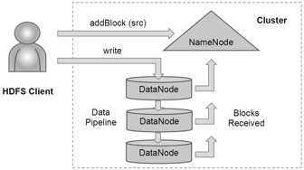
Hadoop
HDFS
  File Writes (Creating a New File)
Notes:
Image pulled from Internet….

Slide 16
Hadoop / MapReduce
Is a software framework for writing applications which process very large datasets (multi-terabyte data sets) in parallel on large clusters of machines. Essentially enabling the user to run analytics across large blocks of data.
The MapReduce Framework takes care of scheduling tasks, monitoring them, and re-executing failed tasks.

Slide 17
Hadoop / MapReduce
The Map Reduce Framework consists of a single master JobTracker and one slave Task Tracker per cluster node.
  Job Tracker
    Coordinates all the jobs run on the system scheduling tasks to run on Task Trackers. If a Job fails then the Job Tracker can re-schedule it to another Task Tracker.
    Stores in-memory information about every running MapReduce Job
    Assigns Tasks to machines in the cluster.
    When a Job Tracker assigns a task to a machine, It will prioritize the task to machines with Data Locality.
  Task Tracker
    Runs Tasks and sends progress reports to the Job Tracker
    Has a local directory to create a localized cache and localized job
    Code is essentially moved to the data (Map Reduce Jars) instead of visa versa. It is more efficient to move around small jar files then moving around data. Map Reduce Jars are sent to Task Trackers to run locally (i.e. machines where the data is local to the task).

Slide 18
Hadoop / MapReduce
MapReduce Example:
  Input a raw weather data file that is comma delimited and determine the maximum temperature in the dataset.
  MAPPER
    Assume the ‘Keys’ of the input file are line offsets between each row of data
    Our user defined Mapper Function simply extracts the ‘Year’ and ‘Temperature’ from each row of input data.
    The Output of our Map Function is sorted before sending it to the Reduce function. Therefore, each key / value in the intermediate output (year, temperature) is grouped by ‘Year’ and sorted by ‘Temperature’ within that year.
  REDUCER
    The Reducer function takes the sorted Map(s) inputs and simply iterates through the list of temperatures per year and selects a maximum temperature for each year.
  Fault Tolerance
    What happens if Map or Reducer Tasks fail?

Slide 19
HBase
HBase is a distributed Key / Value store built on top of Hadoop and is tightly integrated with the Hadoop MapReduce framework. HBase is an open source, distributed, column oriented database modeled after Google’s BigTable.
HBase shines with large amounts of data, and read/write concurrency.
Automatic Partitioning – as your table grows, they will automatically be split into regions and distributed across all available nodes.
Does not have indexes. Rows are stored sequentially, as are the columns written to each row.
HBase makes Hadoop useable for real time streaming workloads which the Hadoop File System cannot handle itself.

Slide 20
OOZIE
Is a workflow scheduler. It manages data processing jobs (e.g. load data, storing data, analyze data, cleaning data, running map reduce jobs, etc.) for Hadoop.
Users create Directed Acyclical Graphs to model their workflow. Oozie at runtime manages the dependencies and execute the actions when the dependencies identified in DAG are satisfied.
Supports all types of Hadoop jobs and is integrated with the Hadoop stack.
Supports data and time triggers, users can specify execution frequency and can wait for data arrival to trigger an action in the workflow.

Slide 21
ZooKeeper
Zookeeper is a stripped down filesystem that exposes a few simple operations and abstractions that enable you to build distributed queues, configuration service, distributed locks, and leader election among a group of peers.
  Configuration Service – store and allows applications to retrieve or update configuration files
  Distributed Lock – is a mechanism for providing mutual exclusion between a collection of processes. At any one time, only a single process may hold the lock. They can be utilized for leader election, where the leader is the process the holds the lock at any point of time.
Zookeeper is highly available running across a collection of machines.
Notes:
Talk about leader election for backups - Zettaset

Slide 22
HIVE
Utilized by individuals with strong SQL Skills and limited programming ability.
Compatible with existing Business Intelligence tools that utilize SQL and ODBC.
Metastore – central depository of Hive Metadata.
  It is comprised of a service and a backup store for the data.
  Usually a standalone Database such as MySQL is utilized for the standalone Metastore.
Partial support of SQL-92 specification

Slide 23
PIG
Pig and Hive were written to insulate users from the complexities of writing MapReduce Programs. MapReduce requires users to write mappers and reducers, compilation of the code, submitting jobs and retrieving the results of the jobs. This is a very complex and time consuming process.
A Pig program is made up up of a series of operations, or transformations that are applied to the input data to produce a desired output. The operations describe a data flow, which is converted into a series of MapReduce Programs.
PIG is designed for batch processing of data. Pig is not designed to handle a small amount of data, since it has to scan the entire dataset.
PIG is comprised of two components:
  The Language (Pig Latin) utilized to express data flows
  The Execution Environment to run Pig Latin Programs.

Slide 24
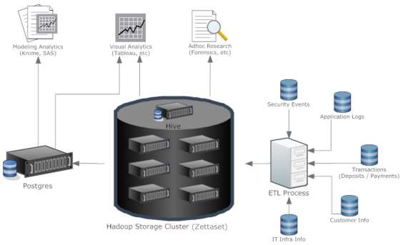
Security Intelligence Ecosystem
Putting it all together
Notes:
Five Pillars needed to turn data into Intelligence:
1) Data Inventory(e.g. Firewall Logs, IDS, AV, Transactional events (Customer Info,
Money Movement), Application Events, Network Traffic Capture, Web Traffic, etc.).
Determine the type of data required and where it is?
2) Extract / Load / Transform (ETL) – Extract the required data, determine frequency,
be able to handle diverse data types, ETL process needs to be fast and support bulk
loading of data, ability to interface with various DBs, and other formats.
3) Security Data Warehouse – Store massive amounts of transactional data and
events, ability to quickly access the data, ability to leverage various reporting and
analytic tools against it, and it must be scalable and cost effective.
4) Analytics – Risk Engines / Commercial engines, Analytics tools for modeling and
visualization, pre-built reports or custom built queries, forensics (query and link
historical data)
5) Alert and Case Management – Ability to handle large amounts of alerts generated,
tying alerts to cases for further analyst work, workflow

Slide 25
Why I Decided to Start Zettaset?
The Drivers behind starting Zettaset
  Realization of the need for a Big Data Platform
  Address some of the shortfalls of the Hadoop Ecosystem.
  Desire to build a turnkey, easily deployable, highly resilient, manageable, Enterprise data analytics platform which enables the aggregation and analysis of massive amounts of data.

Slide 26
How Were the Shortfalls of Hadoop Addressed?
  Building your own Hadoop infrastructure and integrating Hive, Pig, Hbase, Oozie, Zookeeper successfully would be a difficult endeavor. In this section, I will outline the complexities and potential pitfalls an organization would encounter if they attempted to successfully integrate Hadoop, Hive, Pig, Hbase, Oozie, and Zookeeper together into a single deployable platform in their organization.
  The Topics that will be covered in this section include:
    Provisioning / Monitoring
    Availability
    Backup
    HDFS
    Updates to HBase, Pig, and Hive
    Security
    Import / Export
    Scheduling

Slide 27
How Were the Shortfalls of Hadoop Addressed?
  Provisioning / Monitoring
    ISSUES / SHORTFALLS THAT WERE ADDRESSED
      Provision all of your storage, server, and network services
      Distributed logging
      Optimize Configuration for your particular environment to maximize performance of the Cluster.
      Configuration Management
      Alerts (both global and per machine)
      Service Migration
      Performance Monitoring in the cluster
      Automatic installation and provisioning of servers in order to scale to 100s to 1000s of servers.

Slide 28
How Were the Shortfalls of Hadoop Addressed?
  Availability
    Name Node Failure
    Job Tracker Failure
    Hive Metastore Failure
    Time Synchronization Issues
    Substantial operational staff required due to the complexities of maintaining the environment and utilizing Hadoop.
    Key Process failures
    Failure Recovery / Self Healing ability
  Backup
    No Backup tools exist for backing up a Hadoop Cluster of 1000s of TB of Data. Performing incremental or full backups at this scale is beyond the capability of existing backup tools.

Slide 29
How Were the Shortfalls of Hadoop Addressed?
  File System
    While Hadoop can store petabytes of data, Hadoop only supports tens of millions of files, as all file locations and associated blocks are kept in RAM by the HDFS Name Node Master (single point of failure)
  Writing Map Reduce Jobs
    Writing Map Reduce Jobs, no matter how trivial, typically requires programming in Java (or another language).
    In Hadoop, no system exists for periodically scheduling MapReduce jobs -- you can only submit jobs for immediate execution.

Slide 30
How Were the Shortfalls of Hadoop Addressed?
  HBase
    HBase does not have a schema system. A User must determine all of their data encodings and map them to HBase column families and qualifiers.
    Helper Libraries in HBase for encoding your data types (e.g. change integer to byte array) have drawbacks. A default encoding for many data types does not exist (e.g. dates).
    There is no out of the box support for multi-column row keys. The row key is a single byte array. Your schema system must serialize a multi-column row key of whatever given data type into a single byte array to multi-column keys.

Slide 31
How Were the Shortfalls of Hadoop Addressed?
  PIG
    No Multithreading capability
    PIG only supports flat files
    Pig has no user interface
  Hive
    Hive has no user interface
  Security
    The Hadoop ecosystem has only partially adopted Kerberos but many services remain unprotected and use trivial authentication systems.
  Import / Export
    Hadoop has minimal support for reading, and writing different file types.

Slide 32
How Were the Shortfalls of Hadoop Addressed?
  Scheduling
    Mapreduce comes with a primitive scheduling facility which enables a user to submit MapReduce Jobs and in some cases prioritize particular jobs over other Jobs. However, the Scheduler lacks the ability to assign work flow to a job, kill or pause a Running Job. The Scheduler has a primitive UI.
  Hadoop does not have a UI
    Utilized to import / export Data
    Explore the data residing within Hadoop / HDFS
    Manipulate the data directly
    To Monitor System / Node Health
    Enable Security

Slide 33
Future Issues to Address
Future Enhancements
  HBase Coprocessor integration
  Virtual machine deployment of Hadoop
  Hybrid Cluster (optimize cluster with a mixture of Flash and SATA Drives)
  Failover of non-hadoop Big Data Services (e.g. MongoDB)
Notes:
Hbase CoProcessors – Allows you to have in region servers that follows splits
and mergers and can operate with pre and post hooks for any operation
(i.e. before or after inserting data). Essentially, enables you to create code that
can run arbitrary operations on a live data stream before the stream of operations
is completed.

Slide 34

FLASH IMPLEMENTATION

Slide 35
FLASH IMPLEMENTATION
Hardware
  Testing Environment
    HP DL380 Servers (4 Full Size Flash Cards, 2 half size slots)
    Data Size – 9.6 Terabytes Raw
    2 x Intel 5690 Processors (6 Cores w/hyper threading), 3.46 Ghz Processor, Smart Cache – 12MB)
    96GB RAM
    1 x 7124sx (Arista Switch – Layer 2/3/4, 10 Gigabit Ethernet Switch, 24 x 1/10 Gb ports, 500 nano second forwarding speed)
    4x10 GB SFP+ Network Cables (Patch Cables)
    2 x Solarflare 5122 NICs (Dual Port – 10GB Ethernet Adapter)
    8 x 1.2TB PCI Flash Drives
Notes:
Read BW (1MB) = 3 GB/S, Write BW(1MB) = 2.6GB/S, Read IOPS (512B) = 702,000, Write IOPS(512B) = 937,000, Read Latency = 47 Microseconds, Write Latency = 15 Microseconds

Slide 36
FLASH PERFORMANCE
FlashScale BD Terasort Performance Matrix*
Time | 100 GB | 1 TB | 2 TB | 3 TB | 4 TB
1 Node | 0:15:14 | 2:35:53 | N/A | N/A | N/A
2 Node | 0:07:20 | 1:15:02 | N/A | N/A | N/A
3 Node | 0:04:32 | 0:49:15 | 1:39:45 | N/A | N/A
4 Node | 0:03:17 | 0:36:37 | 1:13:47 | 1:53:12 | N/A
5 Node | 0:02:37 | 0:30:16 | 1:00:04 | 1:31:18 | 1:59:11
Oracle x2270 – Single Node – 100GB ➔ 1 Hr 40 Min
Yahoo - 3452 nodes – 100TB ➔ 2 Hr 43 Min
*BD tested with 2.6Ghz x5650 CPUs, shipping with 3.46 Ghz x5690 CPUs
Notes:
5 Node (100TB) = 4TB * 25 = 100TB (25 *2 hours = 50 Hours) for 100TB
– scales Linearly. 5 Nodes. We were processor bound during the tests,
a better processor as indicated would increase the performance by
approximately 10%.
Since we scan linearly, it would take 80 Nodes to process the 100TB Dataset in 3.125
Hours vs. 2 Hr. 43 Minutes with 3452 Notes (43x the servers, 2.3% of the machines to
achieve the same result)
Think of this from a Green perspective, how much power, rack space, and air conditioning
would be saved. Including physical raw materials to build the additional boxes.

Slide 37
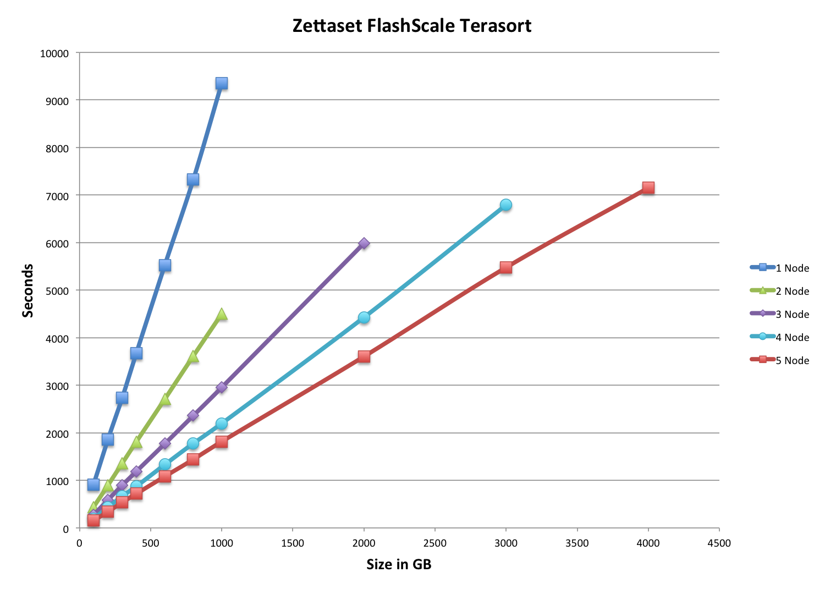
FLASH IMPLEMENTATION

Slide 38

Cloud Computing

Slide 39
Public Cloud
Amazon’s Elastic Compute Cloud (EC2)
  Amazon Elastic Compute Cloud (Amazon EC2) is a web service that provides resizable compute capacity in the cloud. Users can increase or decrease the number of resources at will.
Amazon’s S3 Storage
  It’s a storage service that offers client’s a highly scalable, reliable, and low latency infrastructure.
  Store an large amounts of data (1 byte to 5TB per S3 object)
  Charged by the storage Tier
Amazon’s EBS Storage
  Storage Volumes are similar to raw, unformatted block devices.
  Create storage volumes from 1GB to 1TB that can be mounted as devices by Amazon EC2 images.

Slide 40
Public Cloud
Amazon’s Elastic Compute Cloud (EC2)
  How to Setup A Hadoop Ecosystem in the Cloud?
    Amazon S3
    Amazon EBS
  IP Addressing for Hadoop Service Failover
    Any Service that has an automatic failover would require an Elastic IP Address.
  Items to Consider in Deciding to utilize a Cloud Infrastructure:
    If you need your cluster on 24x7, Amazon’s per CPU costs become very expensive, easily comparable to running your own servers in a datacenter including power / connections.
Notes:
S3 SETUP
1) Hadoop can read datasets from S3 (HDFS), and MapReduce can utilize S3 or local
instances for temporary storage (intermediate results of MAP Task(s)
2) You can create as many VMs as you desire to perform Analytics without
worrying about allocating EBS Volumes
3) S3 is more reliable then EBS. It never loses data
4) S3 is globally available
5) However, S3 is slow. It’s data throughput speed is 20-25 MB/s (1/3 the
speed of a typical SATA Drive) and has latency issues
EBS SETUP
1) You can run HDFS on top of EBS (Elastic Block Storage)
2) Each VM has a permanent set of one or more EBS Volumes associated
with it
3) EBS is not as reliable as S3. If you store data on multiple EBS volumes
(e.g Use Hadoop DFS Replication), you are not guaranteed that the data
is actually being stored by distinct physical machines. Two EBS Volumes
may be served by the same physical machine.

Slide 41
Public Cloud
Items to Consider in Deciding to utilize a Cloud Infrastructure or Not
  Hadoop is RAM and storage intensive; you will need a cluster of large or Extra Large High-CPU instances.
  Amazon’ storage is problematic. S3 is slow and has no locality, but is durable.
  Failover of Primary Components (e.g. Name Node Server) may take several minutes due to the switching of Elastic IPs.
  EBS is faster, but is not as reliable. In addition, EBS is more expensive if you perform large scale analytics, as it charges for both storage and each I/O operations.
  Virtualized, shared network cloud environments such as EC2 often experience periods of high latency during peak traffic conditions, even internal communications within the cluster.

Slide 42
Open Problems
Execution Frameworks that are fault tolerant, scalable, and are amenable to problems that are poorly suited for MapReduce.
Real Time Analysis Frameworks. Hadoop is entirely batch oriented (except for HBase, which is a key-value store, not an analytics platform). For instance, HBase coprocessors, Twitter Storm, Yahoo! S4. We need to explore tradeoffs between durability, consistency, scalability, etc.
Hot Failover, sub second for all services.
Notes:
MapReduce Issues
MapReduce is poor at dealing with any problem where communication patterns
are irregular and algorithms are highly iterative. Each communication round
requires a full MapReduce which takes seconds to start up or teardown.
So if you have an algorithem like k-means which needs machines to talk to
each other over K Rounds, this will take many times K seconds. If
K=1000… things are really bad. So we need a framework that better
addresses these problems (e.g. Google Pregal, Apache Giraph)

Slide 43
Any Questions?

